Slide 1
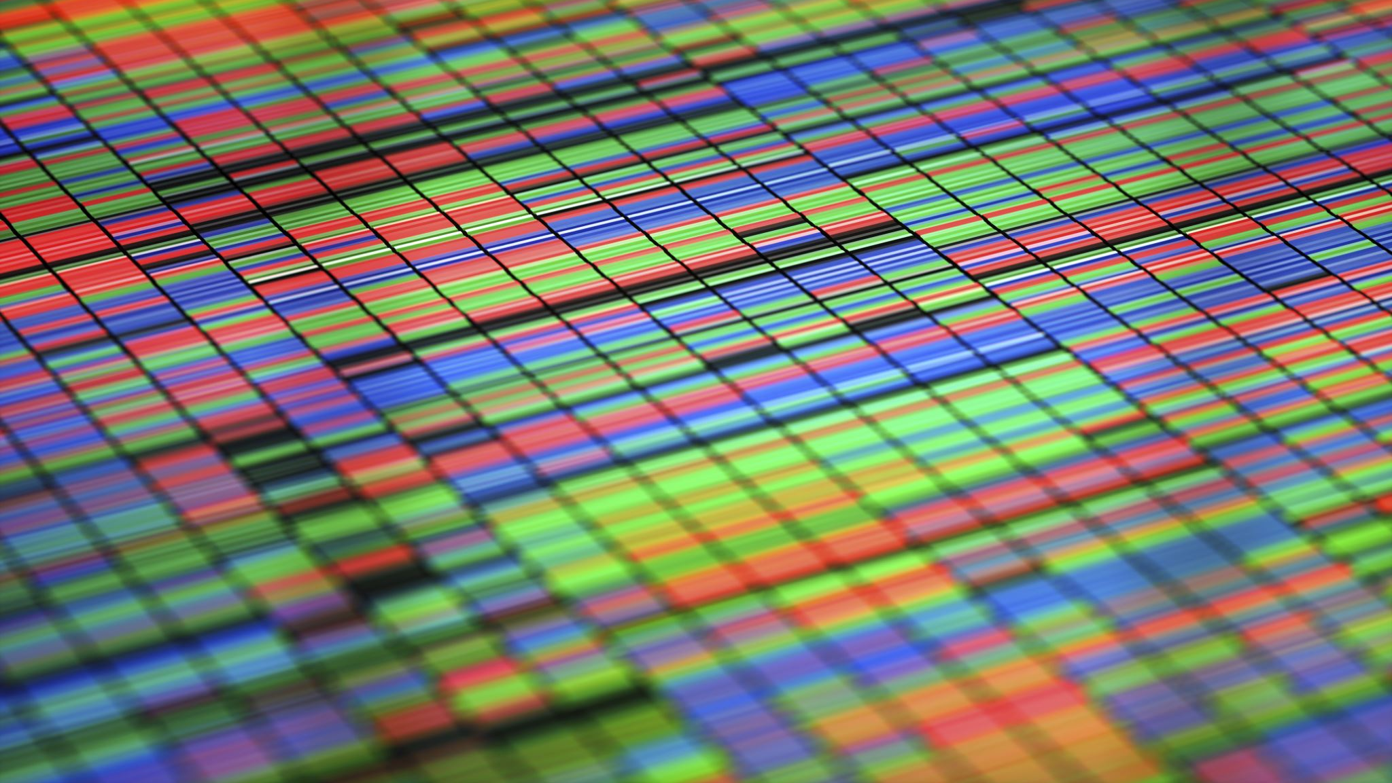
World Indicators_Tableu_Nora Perotti
File created on: 10/5/2025 4:48:00 PM

Slide 2
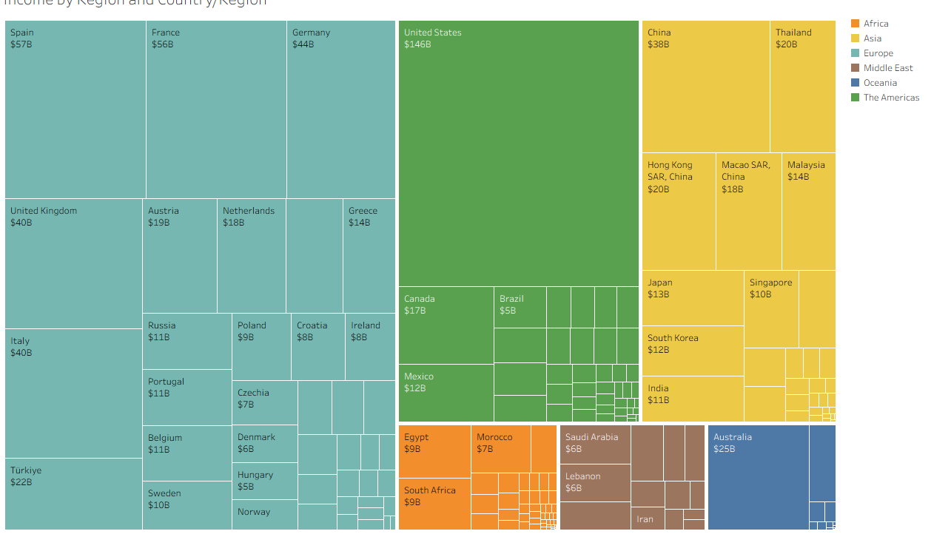

Slide 3
